Slide 1



FINSPARK HACKATHON 2026
AI-Driven Correlation of
Cybersecurity Telemetry &
Transactional Behaviour
An Explainable AI platform that fuses SOC telemetry with banking transaction behaviour to detect fraud, cyber-intrusions, and quantum-era threats — before they settle.
Team Name: Finfusion
Team Members: Sanjana.g.rao,Srujan.g.rao
Date: 11/07/26
Notes:
Welcome the judges. Introduce the team and state the one-line thesis: cyber telemetry and transaction data are analyzed in silos today, and this platform correlates them with explainable AI to catch fraud, intrusions, and quantum-era threats earlier. Keep this to 30-40 seconds — it's the hook, not the detail.

Slide 2



THE CHALLENGE
Cybersecurity and Fraud Signals Are Analyzed in Silos
Banks run two parallel worlds: SOC teams watch login events, firewall alerts, and endpoint telemetry, while fraud teams watch UPI, NEFT, RTGS, card, and ATM transactions. The two views are rarely joined in real time.
High False Positives
Delayed Detection
Rule-based SIEM and fraud engines flood analysts with noise, hiding real threats.
Telemetry and transactions are reconciled after the fact, not at the moment of risk.
A stolen credential and an anomalous transfer look like two unrelated events — until the loss is already realized. And a new class of threat is emerging: Harvest-Now-Decrypt-Later (HNDL), where adversaries quietly exfiltrate encrypted banking data today, to decrypt it once quantum computing matures.
Blind to Quantum Risk
Fragmented Tooling
No visibility into HNDL-style exfiltration aimed at future decryption.
SIEM, fraud, and identity systems don't share a common risk language.
Why correlation, why now
Isolated monitoring reacts after settlement. Contextual, AI-driven correlation lets a bank act at the moment risk is forming — across both the network layer and the money movement layer.
Finspark Hackathon 2026
02
Notes:
Frame the gap: SOC and fraud teams both watch relevant signals but never in a shared context. Call out HNDL explicitly — it's the differentiator judges will remember. Close with the reframe: this isn't a new alert system, it's a shared risk language across cyber and transactional data. Aim for 45-60 seconds.

Slide 3



FOUNDATION
Pre-Requisites for the Platform to Operate
Cyber Telemetry Sources
Transactional & Threat Feeds
Environment & Assumptions
SIEM correlation alerts
UPI, NEFT, RTGS transaction logs
Hybrid cloud / on-prem access
Firewall & IDS/IPS logs
Card & merchant payment logs
Data-sharing & consent approvals
Endpoint / EDR telemetry
ATM withdrawal logs
6-12 months labeled historical data
Authentication & login events
External threat-intel feeds (CTI)
RBI / PCI DSS compliance sign-off
Device & network metadata
Core banking system API access
Sandbox banking environment for PoC
Finspark Hackathon 2026
03
Notes:
Walk through what the platform needs to operate: cyber telemetry sources on the left, transactional and threat-intel feeds in the middle, and the environment/compliance assumptions on the right. This grounds the solution as realistic and bank-deployable, not a toy demo. Keep to 40 seconds.

Slide 4



TECHNOLOGY STACK
Tools & Technologies Powering the Platform
Apache Kafka
Apache Flink
PostgreSQL
TimescaleDB
Neo4j (Graph)
Ingests high-velocity telemetry and transaction streams and stores both time-series and relationship data.
Data & Streaming
Python
XGBoost
Graph Neural Networks
Isolation Forest
SHAP (XAI)
Detects anomalies, correlates entities across data types, and explains every risk score in human terms.
AI / ML Correlation Engine
Docker / Kubernetes
Azure / AWS
HashiCorp Vault
Open Quantum Safe (PQC)
OAuth2 / RBAC
Runs as hardened microservices with secrets management and quantum-safe cryptography baked in.
Platform & Security
FastAPI
React
Grafana
Power BI
REST / GraphQL APIs
Serves real-time dashboards to SOC analysts and integrates into existing bank tooling via open APIs.
Experience & Delivery
Finspark Hackathon 2026
04
Notes:
Move quickly here — this slide exists to show technical depth, not to be read aloud line by line. Point out the graph database and GNN choice for correlation, and the quantum-safe cryptography library, since both map directly back to the problem statement. 40-50 seconds.

Slide 5



FUNCTIONAL WORKFLOW
How a Signal Moves Through the Platform
Supporting artifacts: entity-relationship diagram, correlation-rule logic flow, XAI decision-tree exports, and a fraud-cyber event taxonomy document accompany this pipeline as reference material for reviewers.
1
2
3
4
5
Ingest
Normalize & Enrich
Correlate
Score & Explain
Alert & Act
Stream telemetry & transactions in real time
Standardize events, attach identity & device context
Graph + ML link cyber and transactional entities
Risk score generated with SHAP-based XAI rationale
Prioritized alert routed to SOC / fraud dashboard
Finspark Hackathon 2026
05
Notes:
This is the functional backbone: five stages from raw signal to actionable alert. Emphasize that correlation happens on a graph, not just a rules table, and that every score carries an explanation before it reaches an analyst. Mention supporting docs exist but don't dwell. 45 seconds.

Slide 6

WHY THIS WINS
Key Differentiators & Adoption Plan
Unified Correlation Engine
One graph model joins identity, device, network, and money-movement events.
Adoption Roadmap
Phase 1 · Pilot
Months 0–3
Explainable AI, Not a Black Box
Single-branch PoC on historical data; validate correlation accuracy & false-positive reduction.
Every risk score ships with a SHAP-based, analyst-readable rationale.
Phase 2 · Integration
Quantum Risk Monitoring
Months 3–6
Live SIEM & core-banking API integration; SOC analyst dashboard rollout.
Purpose-built detection for Harvest-Now-Decrypt-Later exfiltration patterns.
Phase 3 · Scale
Adaptive Behavioral Analytics
Months 6–12
Models retrain continuously against evolving fraud and attack behaviour.
Multi-branch, multi-product rollout with quantum-risk module fully active.
Finspark Hackathon 2026
06
Notes:
Four differentiators on the left map directly to the four problems raised earlier — make that callback explicit. The roadmap on the right shows judges this isn't just a hackathon demo; it has a realistic path to production in a bank. 50-60 seconds.

Slide 7




MARKET FIT
Business Potential & Relevance
Target Segments
Public & Private Banks
NBFCs & FinTechs
Payment Processors / PSPs
Regulators & SOC-as-a-Service
Revenue & Deployment Model
SaaS Platform Licensing
Transaction-Based Pricing
Managed SOC Add-On
Annual license per bank, tiered by transaction volume & module coverage.
Usage-based fee per correlated transaction for mid-size PSPs & NBFCs.
White-labeled analyst-as-a-service offering for smaller institutions.
Finspark Hackathon 2026
07
Notes:
The buyer isn't just one bank — it's the whole regulated payments ecosystem: banks, NBFCs, PSPs, and regulators who need SOC-as-a-service. Walk through the three monetization paths briefly; the point is optionality, not a single bet. 40-50 seconds.

Slide 8
COMPETITIVE POSITION
Uniqueness of Approach and Solution
Capability
Traditional SIEM
Traditional Fraud Engine
Our Platform
Cyber ↔ Transaction Correlation
None
None
Full
Explainable Risk Scoring
Partial
None
Full
Quantum / HNDL Risk Awareness
None
None
Full
Graph-Based Behavioral Analytics
None
Partial
Full
Adaptive False-Positive Reduction
Partial
Partial
Full
Finspark Hackathon 2026
08
Notes:
This table is the punchline of the uniqueness argument: existing SIEM and fraud tools each see half the picture, and neither watches for quantum-era exfiltration. Let the 'Full' column speak for itself — don't over-explain each row. 40 seconds.

Slide 9


ANALYST EXPERIENCE
One Unified View for the SOC & Fraud Team
SOC COMMAND DASHBOARD — LIVE
One Unified View
Cyber alerts and transaction anomalies in a single case, not two consoles.
18
6
72
2
Active Alerts
Correlated Cases
Avg. Risk Score
Quantum Flags
One-Click Explainability
Every score expands into the exact contributing factors, in plain language.
CYBER–TRANSACTION CORRELATION TIMELINE
Role-Based Views
SOC analyst, fraud investigator, and compliance officer each see a tailored layout.
EXPLAINABLE AI RATIONALE
Real-Time Refresh
• New device + login from unusual geo (+32)
• RTGS transfer 5.4x above baseline (+41)
• Endpoint flagged by EDR 6 min prior (+19)
RISK SCORE
Streaming updates with no manual reconciliation between systems.
92
Critical
SCREENSHOT / DEMO PLACEHOLDER
Finspark Hackathon 2026
09
Notes:
This wireframe stands in for the live dashboard demo. Walk left to right: KPI strip for situational awareness, the correlation timeline, the plain-language XAI rationale, and the risk score. On the right, call out that different roles see different views of the same case. 50-60 seconds, longer if this is where the live demo happens.

Slide 10



BUILT TO GROW
Scalability Across Branches, Volumes & Geographies
Single Branch
Multi-Branch Bank
Multi-Bank Platform
Cross-Border Deployment
Pilot on one branch's telemetry & transaction volume.
Horizontally scaled microservices absorb branch-level load.
Multi-tenant isolation supports several institutions.
Regional data residency & localized compliance rules.
Event-Driven Microservices
Kafka Partitioned Streaming
Elastic Model Serving
Each pipeline stage (ingest, correlate, score, alert) scales independently on Kubernetes.
Millions of daily events partitioned by entity for parallel, low-latency processing.
GPU/CPU autoscaling for ML & graph inference during peak transaction windows.
Finspark Hackathon 2026
10
Notes:
Scalability has two dimensions: organizational growth (top row — branch to cross-border) and technical elasticity (bottom row). Keep this brisk; judges care that the architecture doesn't fall over at bank-scale volume, not the implementation minutiae. 40 seconds.

Slide 11
OPERATIONAL READINESS
Ease of Deployment & Maintenance
Containerized Everywhere
CI/CD Pipelines
API-First Integration
Docker images orchestrated by Kubernetes for consistent, portable deployment.
Automated build, test, and rollout with blue-green deployment for zero downtime.
REST/GraphQL connectors plug into existing SIEM & core-banking systems.
Centralized Observability
Automated Model Retraining
Self-Service Configuration
Unified logging, tracing & alerting via Grafana/Prometheus stack.
Scheduled retraining pipelines keep detection models current as behaviour shifts.
Analysts tune correlation rules & thresholds without engineering tickets.
Finspark Hackathon 2026
11
Notes:
Six operational pillars, two rows. This slide exists to reassure judges an IT team could actually run this day-to-day — containerized, CI/CD'd, observable, self-tuning. Pick two to elaborate verbally (e.g., CI/CD and automated retraining) and let the rest stand on the slide. 40 seconds.

Slide 12


SECURITY & COMPLIANCE
Security Considerations
End-to-End Encryption
Zero Trust & RBAC
Immutable Audit Logs
TLS in transit, AES-256 at rest across every data store.
Every service call authenticated; least-privilege role-based access.
Tamper-evident logging of every alert, score, and analyst action.
Data Masking & Privacy
Regulatory Compliance
Quantum-Safe Cryptography
PII and account data masked in non-production and analyst views.
Aligned to RBI guidelines, PCI DSS, ISO 27001, and GDPR principles.
Post-quantum algorithms (PQC) mitigate Harvest-Now-Decrypt-Later exposure.
Finspark Hackathon 2026
12
Notes:
Dark slide for gravitas — this is the trust slide. Five standard controls plus the one that differentiates the pitch: quantum-safe cryptography directly addressing HNDL. Land on that last box. 40-50 seconds.

Slide 13
TECHNICAL BLUEPRINT
System Architecture
DATA SOURCES
Cyber Telemetry
(SIEM, Firewall, EDR, Auth)
Transactions
(UPI · NEFT · RTGS · Card · ATM)
External Threat-Intel Feeds
INGESTION & STREAMING
Kafka Event Bus
Stream Normalization & Enrichment
Data Lake (raw + curated)
CORRELATION & AI ENGINE
Graph Correlation
Engine
Fraud & Anomaly
ML Models
Quantum Risk
Module (HNDL)
Explainable AI
(SHAP)
RISK ORCHESTRATION
Unified Risk Scoring
Alert & Case Orchestrator
EXPERIENCE LAYER
SOC Analyst Dashboard
Fraud Investigator View
Admin & Compliance Console
Finspark Hackathon 2026
13
Notes:
Walk top to bottom: raw cyber and transaction sources feed a Kafka streaming layer, which lands in the graph correlation and AI engine — this dark band is the core IP, including the quantum risk module and XAI. Scores flow to an orchestrator that raises cases into role-specific dashboards. Keep it to the flow, not every box. 50-60 seconds.

Slide 14
PROTOTYPE
Solution Screens & Dashboard Mockups
SCREENSHOT PLACEHOLDER
SCREENSHOT PLACEHOLDER
SCREENSHOT PLACEHOLDER
SOC Command Dashboard
XAI Threat Explanation
Cyber–Transaction Timeline
Live KPI strip, correlated case queue, and quantum-risk flags.
Plain-language rationale behind every risk score.
Chronological view linking a login event to its downstream transaction.
Finspark Hackathon 2026
14
Notes:
These three panels will hold live product screenshots or a short embedded demo clip before the final submission — for now they're intentionally marked as placeholders. Describe what each will show in one sentence rather than apologizing for the placeholder. 30-40 seconds.

Slide 15

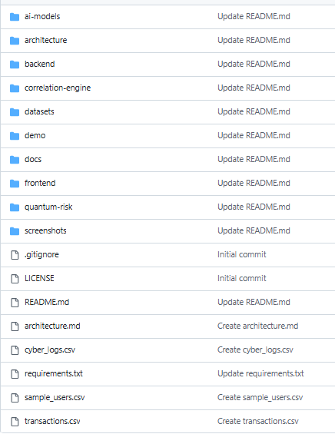
PROOF OF WORK
GitHub Repository & Demo Information
Suggested Structure
Repository
AI-Cyber-Transaction-Correlation
Repository URL:-https://github.com/sanjanagraomys06-rgb/AI-Cyber-Transaction-Correlation
Repository Includes:-
Source Code
AI & ML Models
Backend APIs
Frontend Dashboard
Sample Datasets
System Architecture
Project Documentation
Demo Resources
README includes: problem context, setup steps, architecture diagram, sample data, and demo walkthrough.
Finspark Hackathon 2026
15
Notes:
Point to the repo structure as evidence the architecture from earlier slides is actually implemented, not just conceptual. Mention the demo video and QR code will link to a live walkthrough. 30 seconds.

Slide 16
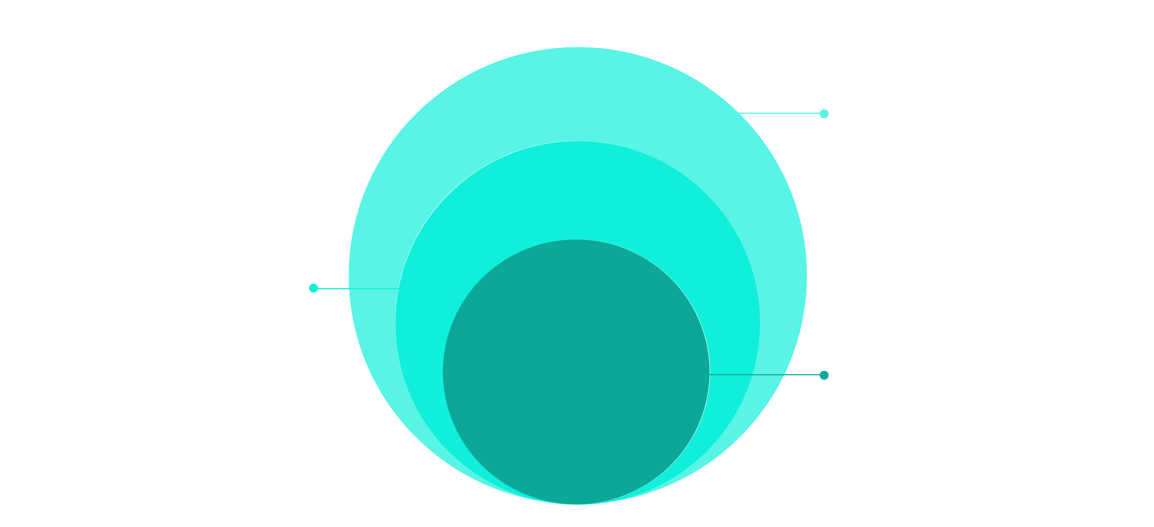
AI-Driven Correlation of Cybersecurity Telemetry & Transactional Behaviour
Thank You
Response Layer
SOAR, alerts and case management
Threat Intelligence
Real-time scoring and pattern matching
AI Correlation
ML models and anomaly detection
IntelliGuard AI's four-layer architecture ingests raw telemetry and transactional data, applies ML-based anomaly detection, scores threats in real time, and triggers automated response actions — all within milliseconds.
Correlating what your systems already know — so threats are caught before they settle.
Finspark Hackathon 2026
16
Notes:
Close with the one-line thesis restated, thank the judges, and invite questions. Have the GitHub link and contact info visible for follow-up. 15-20 seconds.

